Slide 1
Practice Lab:
This Practice Lab is dependent on Discussion Module 7449, where most of the objects we create in this lab were introduced.
This Practice Lab requires a working DSE system, with DSE Search enabled, and with ability to execute CQL DDL.
All other commands are run from CQLSH, DSE Studio, or the Solr Admin UI.
DSE Search, Text Part 2
Notes:
The goal of this Practice Lab is to use implement and test the ideas introduced in Discussion Module 7449.
Runtime requirements are detailed in the slide above.

Slide 2
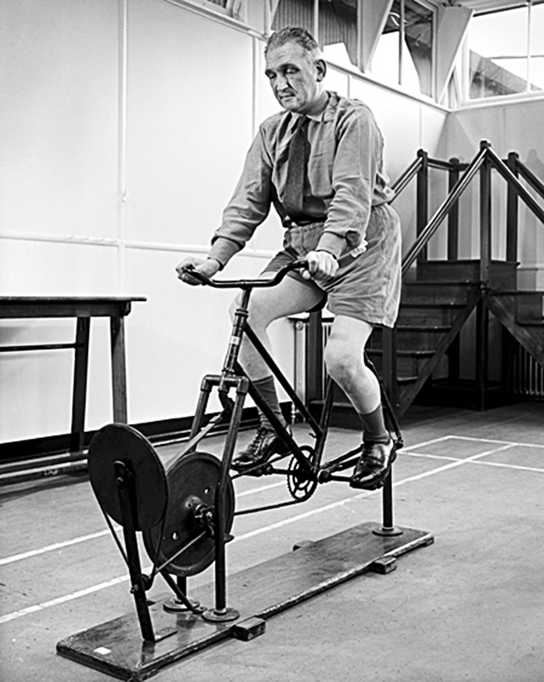
Challenge 1: Score using Solr Admin UI
.. VALUES ('aaa', 'test space‘ , 'test');
.. VALUES ('bbb', 'space test‘ , 'test');
.. VALUES ('ccc', 'test one two space‘ , 'test');
.. VALUES ('ddd', 'test one two three space‘ , 'test');
.. VALUES ('eee', 'test one two three four space‘ , 'test');
Use CQL to CREATE TABLE, CREATE | ALTER SEARCH INDEX, INSERT (data)
Use Solr Admin UI to observe Tf-Idf scoring as outlined in module 7449.
Notes:
Sample syntax above to harvest ideas from in this module and module 7449, apply to the goals outlined above.

Slide 3
Challenge 1: Score using Solr Admin UI
You are done when you have produced screens similar to these, and understand score, and Tf-Idf values-
"ddd": "0.7590632 = weight(col2:three in 4) [], result of: 0.7590632 = score
(doc=4,freq=1.0 = termFreq=1.0), product of: 0.87546873 = idf(docFreq=2, docCount=5)
0.86703634 = tfNorm, computed from: 1.0 = termFreq=1.0 1.2 = parameter k1
0.75 = parameter b 3.8 = avgFieldLength 5.2244897 = fieldLength“
"eee": "0.6454073 = weight(col2:three in 0) [], result of: 0.6454073 = score
(doc=0,freq=1.0 = termFreq=1.0), product of: 0.87546873 = idf(docFreq=2, docCount=5)
0.73721343 = tfNorm, computed from: 1.0 = termFreq=1.0 1.2 = parameter k1
0.75 = parameter b 3.8 = avgFieldLength 7.111111 = fieldLength"
Notes:
Using the Solr Admin UI, produce the score, and the Tf-Idf values that produce same.

Slide 4
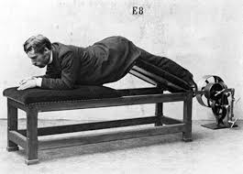
Challenge 2: Boosting Query-
Create two columns; one straight index, one sounds like.
Create an OR query with the straight index boosted higher than the sounds like.
Test to ensure exact match columns return higher
Notes:
Harvest ideas from in this module and module 7449, apply to the goals outlined above.

Slide 5
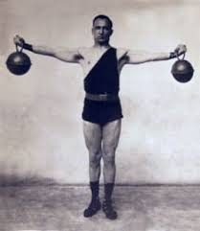
Challenge 3: Experiment with Fuzzy Search
Create two columns; both straight index
Create an OR query with the straight index boosted higher than the fuzzy search.
Test to ensure exact match columns return higher
SELECT * FROM t6
WHERE solr_query =
'{ "q" : "(col73:%huck^8 OR
col74:chuck~1)" }' ;
Notes:
Harvest ideas from in this module and module 7449, apply to the goals outlined above.

Slide 6

Discussion Lab:
Lessons learned
Notes:
Discuss what worked well, poorly, from the Practice Lab.

Slide 7
End of Module:
Notes:
End of Practice Lab-

